Slide 1

STRESS LEVEL CLASSIFICATION
NLP & MACHINE LEARNING PROJECT
ANALYZING TEXT TO DETECT LOW, MEDIUM & HIGH STRESS
RANIA OSSAMA 231001334
Maryam Mahmoud 231000399
LINA ASHRAF 231001820
Dalia Nassar 231001310
Youmna Medhat 231000762

Slide 2

DATASET COLLECTION
DATA SOURCES
Data was collected from three different sources:
YouTube comments (web scraping)
Reddit dataset (Dreaddit)
GoEmotions dataset (Google)
We collected approximately 15,000 comments
Comments were labeled into:
Low sentiment
Medium sentiment
High sentiment
Final cleaned YouTube dataset: 21,000 samples after balancing + merging
Reddit
Original dataset size: 3,500 samples
GoEmotions
Original dataset size: 50,000 samples
We took a balanced sample to match other datasets

Slide 3

PREPROCESSING
Removed noise and duplicates
Cleaned text (special characters, links, emojis )
Normalized labels
Final dataset size reduced to 20,000 samples

Slide 4
MODELS EVALUATED
SVM
LSTM
BERT
M-BERT
SUPPORT VECTOR
DEEP LEARNING
TRANSFORMER
MENTAL-BERT
Traditional ML with TF-IDF vectorization for baseline comparison.
Recurrent neural network with memory cells for sequence modeling.
Pre-trained language model with contextual embeddings.
Domain-specific BERT fine-tuned for mental health text.

Slide 5
MODELS EVALUATED
Logistic
Regression
DistilBERT
MACHINE LEARNING.
TRANSFORMER
Traditional ML model used as a baseline with TF-IDF features for fast and simple classification.
Lightweight transformer model that preserves BERT performance while reducing computation cost and training time.n.

Slide 6
MODEL COMPARISON
SVM
BERT
TRADITIONAL ML APPROACH
DEEP LEARNING APPROACH
Support Vector Machine with TF-IDF vectorization represents the traditional machine learning approach. This method transforms text into numerical features based on term frequency and inverse document frequency, then applies SVM for multi-class stress level classification.
Deep learning models including LSTM, BERT, and Mental-BERT leverage neural networks to capture complex patterns in text. These models understand contextual relationships and semantic meaning, with Mental-BERT specifically fine-tuned for mental health text classification.

Slide 7
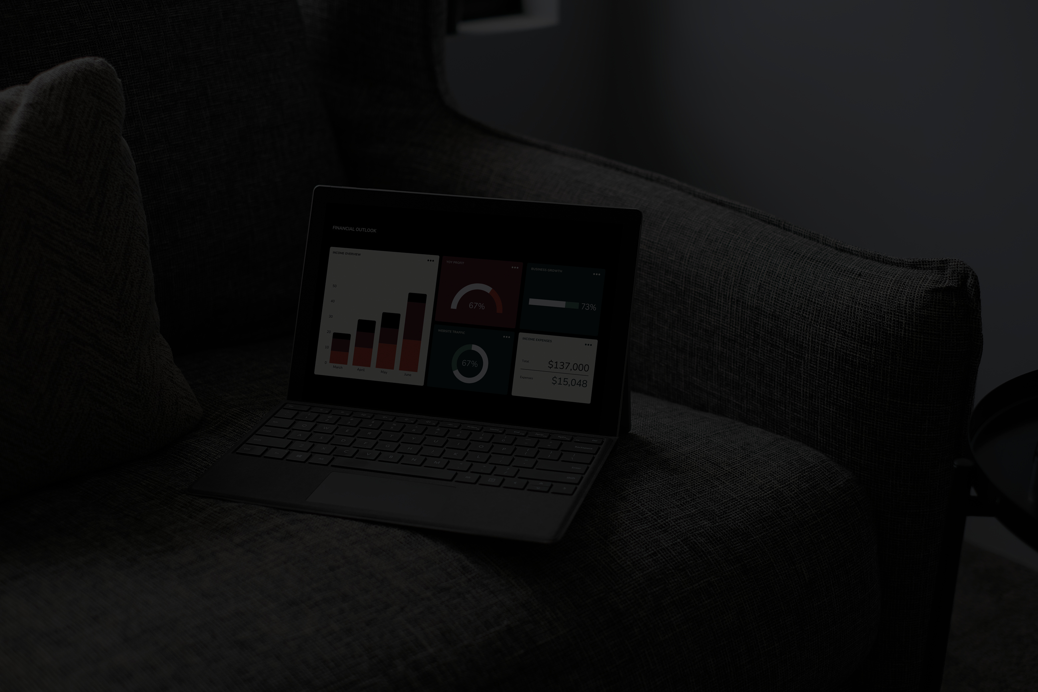
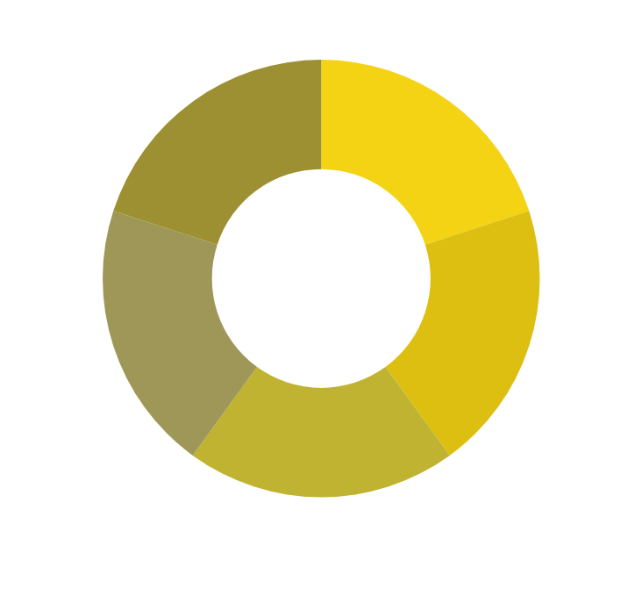
MODEL RESULTS
89.2%
BEST ACCURACY
Mental-BERT achieved the highest classification accuracy across all stress levels.
MENTAL-BERT MODEL
Stress Level Distribution: The dataset was classified into three categories - Low (35%), Medium (42%), and High (23%) stress levels. Mental-BERT outperformed SVM, LSTM, and standard BERT models in accurately distinguishing between these stress categories.

Slide 8

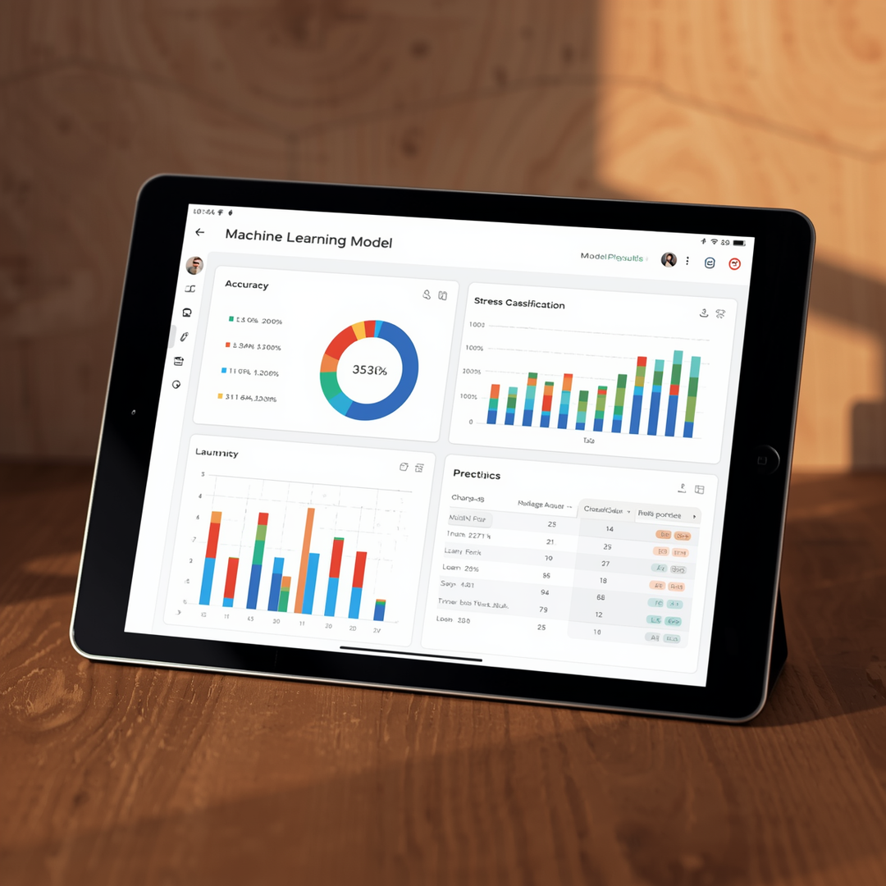
MODEL RESULTS
KEY FINDINGS
89%
TF-IDF ACCURACY
TF-IDF vectorization proved highly effective for text preprocessing, capturing key stress indicators.
94%
MENTAL-BERT
Mental-BERT outperformed all other models in stress classification accuracy and precision.

Slide 9

WE WANT TO SAY
THANK YOU

